Slide 1



AI for Leaders
Instructor-Led
Onsite or Remote
~7 Hours
Program Overview
The What, How, and Why of AI 105 minutes | Articulate the value of AI and ML. Describe the process by which AI is created, applied, and managed.
Choosing AI Projects 120 minutes | Determine the projects or problems that would benefit the most from an AI solution.
Responsible AI 45 minutes | Proactively identify the ethical, security, and privacy risks that may arise when integrating AI.
AI in the Organization 60 minutes | Determine the key conditions needed for an AI project to be implemented successfully in your organization.
Opening, Wrap Up 60 minutes
Overview:
Leaders will gain fluency in AI — including how it works and its ethical implications — to identify opportunities to incorporate AI in their organization.
Learner Audience:
Translators and domain decision-makers (e.g., product managers/owners, business managers/strategists, analysts, subject matter experts)
Business Outcomes:
Conceptualize where AI can be a value-add to the business.
Weigh ethical considerations against business goals when developing AI solutions.
Identify and scope AI projects that add real business value to the organization.
‹#› | © 2020 General Assembly

Slide 2
Schedule: One Full Day
Time | Section
9–9:30 a.m. | Welcome and Introductions
9:30–11:30 a.m. | The What, How, and Why of AI (includes 15-minute break)
11:30 a.m.–12:30 p.m. | Choosing AI Projects (Part 1)
12:30–1:30 p.m. | Lunch
1:30–2:30 p.m. | Choosing AI Projects (Part 2)
2:30–3:30 p.m. | Responsible AI (includes 15-minute break)
3:30–4:30 p.m. | AI in the Organization
4:30–5 p.m. | Bring It Home

Slide 3
Schedule: Two Half-Days
Time | Section
Part 1
9–9:30 a.m. | Welcome and Introductions
9:30–11:30 a.m. | The What, How, and Why of AI (includes 15-minute break)
11:30 a.m.–12:30 p.m. | Choosing AI Projects (Part 1)
12:30–12:45 p.m. | Wrap Up
Part 2
9–9:15 a.m. | Welcome Back
9:15–10:15 a.m. | Choosing AI Projects (Part 2)
10:15–11:15 a.m. | Responsible AI (includes 15-minute break)
11:15 a.m.–12:15 p.m. | AI in the Organization
12:15–12:45 p.m. | Bring It Home

Slide 4
How to Use This Deck
Make a copy of this deck (File > Make a copy).
Retitle your copy of the deck in the following format: AI for Leaders: <client name>, <program date YYYY-MM-DD>
Review the Instructor Guide to understand the overall program and how the content can be adapted.
Review the baseline and identify areas in the program that should be customized. Specific slides that need to be reviewed are indicated with a yellow or green “Customize it!” marker. You should only customize sections of the program with this marker. As available, your GA Client Success Manager (CSM) will provide information from the client to guide the adaptations.
Are you teaching in a remote classroom? In the speaker notes, look for instructions that say For remote classrooms for guidance on how you’d adapt the material for a live online setting. In particular, look for the notes on adapting exercises and discussions for remote classrooms. Reach out to your GA team for any additional support you need.
Share the adapted program deck with your instructor(s) and GA team. Set up time to review the program materials and determine who will teach each section.
Review the Run of Show and make sure the sections, timing, and notes align with your adaptations to the program deck.

Slide 5
What’s in This Deck?
Activity + Debrief Guide
Slides with this label are “skipped” slides that come immediately before an activity or discussion. They contain additional notes for the instructor on how to frame the activity, things to look out for, and how to lead a debrief on the activity. Review these slides carefully to prepare for the program delivery.
Slides with this label should be edited based on the client’s context and needs. This might include slides that require input from the client, case studies that can be swapped, or slides that need minor edits. Your CSM will provide client input to give you guidance on how and what to change.
Yellow “Customize it!” notes represent slides that require more adaptation. Green “Customize it!” buttons represent slides that require less adaptation.
For slides that have the “Customize it!” label, instructions on how to customize the material are in the speaker notes.
Customize it!
Customize it!
For remote classrooms
If you’re teaching a remote class, some slides or activities may need to be adjusted. In the speaker notes of each slide, look for the “For remote classrooms” instructions on how to adjust the slide for a live online setting as needed. In particular, look for the notes on adapting exercises and discussions for remote classrooms.

Slide 6
Resources: Program Materials
Program Materials Folder | Contains all materials for this program, including the materials listed below.
High-Level Design | A high-level overview of the program goals and agenda.
Instructor Guide | How to adapt the material and prepare for the course. Overview of the AI for Leaders program.
Run of Show | Detailed timing and instructions for the program. Includes a list of materials needed for the program.
Student Materials | Worksheets participants will use throughout the program: Google Slides. PowerPoint. No changes are required for the worksheets. Folder of case study PDFs for students to use in the “Choosing AI Projects” section. Case studies can be changed or swapped for relevancy to the client’s industry.

Slide 7
AI for Leaders

Slide 8
Welcome & Introductions
AI for Leaders
Welcome & Introductions
The What, How, & Why of AI
Choosing AI Projects
Responsible AI
AI in the Organization
Bring It Home
Notes:
DURATION: 30 Minutes

Slide 9



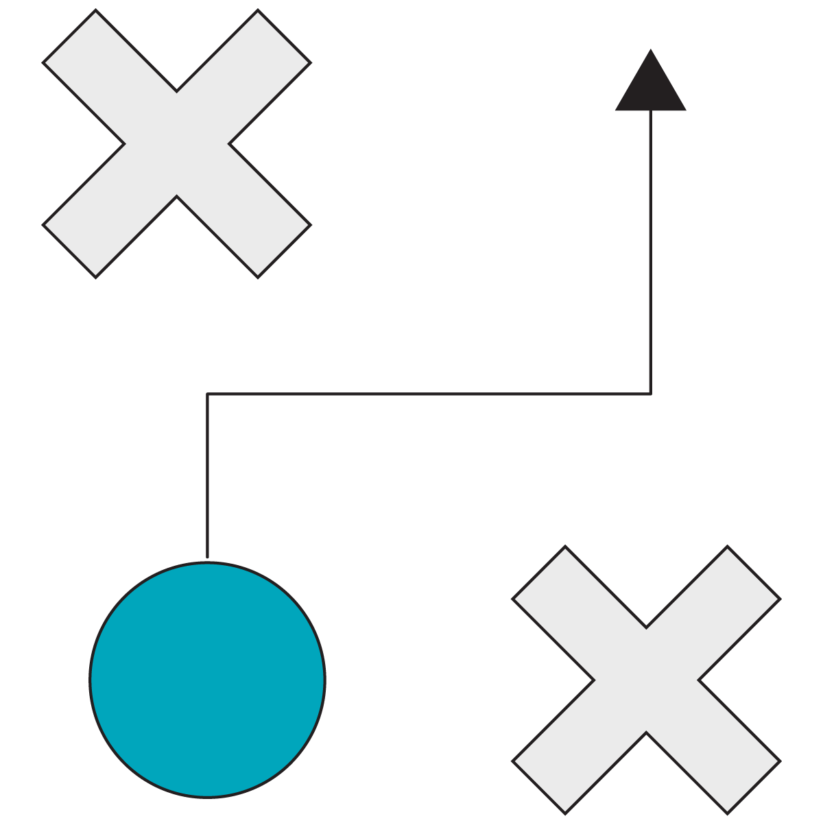


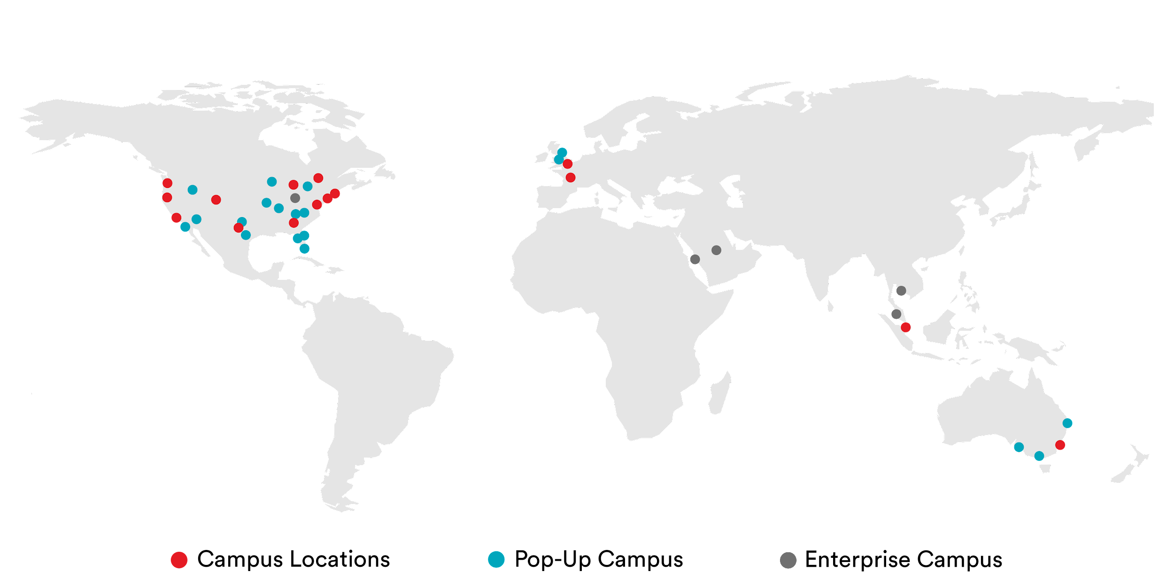
Who we are and what we do?
General Assembly
Accelerate Digital Transformation Through Enabling Talent
Digital Fluency
Engineering & Technology
General Assembly is a global upskilling and reskilling company with unmatched scale. Our programs enable teams to grow, compete, and thrive in the digital economy.
Marketing
Product Management
Data & AI
UX & Visual Design
400 clients including 35 Fortune 100 companies.
50,000 employees trained in 80 cities.
1,500 instructors and 20,000 in-network experts.
78,000 course alumni across 33 campuses.
10,000 live online learners in 5 years of remote delivery.
Fast Facts
General Assembly is a brand of the Adecco Group, the world's foremost provider of staffing, career transition, and talent development solutions.
Notes:
You all have heard about GA before and that we are part of the Adecco Group, but let me tell you a little more about who we actually are.
We are your colleagues, a global team of individuals who are extremely passionate about helping other individuals achieve their career aspirations,
and in particular, teach those individuals the most in-demand digital and tech skills.
We work with many Fortune 500 clients, powering their upskilling and reskilling academies to enable people grow, compete, and be successful in the digital world.
The key areas that we help enable are Digital Fluency (and Digital Foundations programme forms part of this capability), but also more function or role-specific training like Marketing, Technology, Data, Product and UX. And we help people achieve their learning goals offering learning journeys that target their specific growth needs.. Some fast facts about us:
We have helped over 400 clients including 35 Fortune 100 companies.
We have trained over 50,000 employees in 80 cities around the globe.
Our instructor network is made up of 1,500 instructors and 20,000 in-network experts.
78,000 course alumni across 33 campuses.
10,000 online learners in 5 years of remote delivery.

Slide 10



At a Glance
100,000+ global alumni
5,000 expert instructors
500+ enterprise clients
33+ campuses around the world
7,000+ hiring partners
35,000+ assessment takers
2 standards boards
50+ NPS
100,000+ students have taken full- and part-time courses at General Assembly.
94.1% of students who participated in our Career Services program got a job in their field of study within 180 days of graduating.
‹#› | © 2020 General Assembly
Notes:
SPEAKER: Client Success Manager
PURPOSE: Introduce GA to the participants and explain our history and mission.

Slide 11
Meet Your GA Team
Customize it!
Name
Name
Add team member’s face.
Add team member’s face.
Title
Title
‹#› | © 2020 General Assembly
Notes:
SPEAKER: GA Team
PURPOSE: Introduce GA team members (CSM, IM, and more) to the participants and explain our history and mission.
Customize it! Work with your GA team to get their pictures/names/titles onto the slide.

Slide 12
Meet Your Instructors
Customize it!
Add your face.
Name
Title
Add
Your
Bio
‹#› | © 2020 General Assembly
Notes:
SPEAKER: Instructor No. 1
PURPOSE: Introduce yourself and your background to participants.
Customize it! Fill out the missing sections of this slide with your information: photo, name, title, and relevant bio.

Slide 13
Meet Your Instructors
Customize it!
Add your face.
Name
Title
Add
Your
Bio
‹#› | © 2020 General Assembly
Notes:
SPEAKER: Instructor No. 2
PURPOSE: Introduce yourself and your background to participants.
Customize it! Fill out the missing sections of this slide with your information: photo, name, title, and relevant bio.

Slide 14




Ground Rules
Be Here
Now
Breaks
+ Lunch
Be Engaged
EOD
Survey
Connect and collaborate.
No email or phone.
Use the time to stretch, have a snack, and check email as needed.
Take notes and ask questions.
Your feedback makes us better.
‹#› | © 2020 General Assembly
Notes:
PURPOSE: Establish ground rules about how participants should act and interact during the program.
TEACHING TIPS:
Ask if participants want to share any other ground rules.
FOR REMOTE CLASSROOMS:
Work with your GA team to source any additional slides that describe classroom norms and rules for remote classrooms.

Slide 15
Our Learning Goals
At the end of this program, you will be able to:
Articulate the value of artificial intelligence (AI) and machine learning (ML).
Describe the process by which AI is created, applied, and managed.
Determine the projects or problems that would benefit the most from an AI solution.
Proactively identify the ethical, security, and privacy risks that may arise when integrating AI.
Determine the key conditions needed for an AI project to be implemented successfully in your organization.
Notes:
PURPOSE: Frame the ultimate goals for the workshop.

Slide 16

Looking Ahead
Customize it!
Time | Section
9–9:30 a.m. | Welcome & Introductions
9:30–11:30 a.m. | The What, How, & Why of AI (+ 15-minute break)
11:30 a.m.–12:30 p.m. | Choosing AI Projects
12:30–1:30 p.m. | Lunch
1:30–2:30 p.m. | Choosing AI Projects
2:30–3:30 p.m. | Responsible AI (+ 15-minute break)
3:30–4:30 p.m. | AI in the Organization
4:30–5 p.m. | Bring It Home
Notes:
PURPOSE: Share detailed timing for the program.
TALKING POINTS:
Call out timing of breaks and lunch.
Note that these are rough estimates, but we’ll try to stick to them.
Customize it!
Use this agenda if you’re teaching the program all in one day. Delete the next slide.
Update this agenda if the program starts or ends at different times.

Slide 17
Looking Ahead
Customize it!
Part 1
Time | Section
9–9:30 a.m. | Welcome & Introductions
9:30– 11:30 a.m. | The What, How, & Why of AI (+ 15-minute break)
11:30a.m.– 12:30 p.m. | Choosing AI Projects
12:30– 12:45 p.m. | Summary
Part 2
Time | Section
9–9:15 a.m. | Welcome Back
9:15–10:15 a.m. | Choosing AI Projects
10:15–11:15 a.m. | Responsible AI (+ 15-minute break)
11:15 a.m.– 12:15 p.m. | AI in the Organization
12:15– 12:45 p.m. | Bring It Home
Notes:
PURPOSE: Share detailed timing for the program.
TALKING POINTS:
Call out timing of breaks and lunch.
Note that these are rough estimates, but we’ll try to stick to them.
Customize it!
Use this agenda if you’re teaching the program over two chunks. Delete the previous slide.
Update this agenda if the program starts or ends at different times.

Slide 18

What Is AI?
5 Minutes
On your own, take a moment to jot down:
What do you think of when you hear the words artificial intelligence?
Let’s share out and discuss as a group.
Notes:
PURPOSE: Get students to reflect on preconceptions and opinions about AI.
TEACHING TIPS:
Students can take this prompt in any direction they want: AI for work, AI in their personal lives, AI in the movies or pop culture, and more. It’s mostly for them to start thinking about what AI is and what it means to them.
FOR REMOTE CLASSROOMS:
Take a screenshot of this slide and drop it in the Slack channel.
Ask students to thread their responses. They don’t need to wait to press enter — it will be like "calling out" in a physical classroom.

Slide 19
The What, How, & Why of AI
AI for Leaders
Welcome & Introductions
The What, How, & Why of AI
Choosing AI Projects
Responsible AI
AI in the Organization
Bring It Home
Notes:
DURATION: 105 Minutes

Slide 20
The What, How, and Why of AI
105 Minutes
Why?
Leaders don’t need to know the precise mechanics of how AI works. But to guide and encourage teams to leverage AI effectively, leaders do need to understand what the technology is all about, as well as the tools and data it depends on.
Learning Objectives:
Define artificial intelligence and machine learning.
Identify the types of problems that AI and machine learning can solve.
Describe the role that data plays in AI.

Slide 21


You Can Use an iPhone Without Knowing How It Works
Focus Here
Not Here
Notes:
PURPOSE: Emphasize the level of understanding students need about AI.
TALKING POINTS:
Most of us probably don’t know how our phones work “under the hood” — but we know how to use them and get value from them.

Slide 22



Same Goes for AI
Not Here
Focus Here
Notes:
PURPOSE: Emphasize the level of understanding students need about AI.
TALKING POINTS:
AI is similar — it’s not about understanding the mechanics, but knowing how it works and how it can help you.
So don’t be intimidated if AI seems complicated and scary.

Slide 23

A Few Definitions
Artificial Intelligence
Machine Learning
Systems that appear to be “intelligent” and can perceive their environment and respond in a way that is likely to achieve some goal.
The study of algorithms that allow computer programs to automatically improve through experience. ML finds patterns in data and makes predictions about new data.
Notes:
PURPOSE: Define artificial intelligence and machine learning.
TALKING POINTS:
There’s no one set definition of what AI is, and our understanding and definition of AI changes as technology develops. Tasks that would have been classified as AI in the past no longer are.
These are just a starting point for our understanding.

Slide 24
Where We’ll Focus Today
ML is just one way to achieve AI — but it’s the most effective way we currently have.
We’ll focus on ML in this workshop.
Artificial Intelligence
Machine Learning
Notes:
PURPOSE: Expand on the relationship between AI and ML and why we’re focusing mostly on ML in this workshop.
TALKING POINTS:
AI is a general, theoretical term for a machine that can respond to various inputs in useful ways.
Machine learning is a specific type of technology where a computer learns how to do something from examples. It’s one way to try to achieve AI.
Currently, it’s the most effective approach that we have. As a result, this workshop will focus on machine learning.

Slide 25
Comparing Cats & Dogs
This exercise is designed to explain different types of machine learning (supervised, unsupervised, and reinforcement) through a tangible example: distinguishing between types of animals.
Give students some time to brainstorm a variety of ways to approach the problem, then walk through how those methods relate to the types of ML. You don’t need to spend a lot of time debriefing the exercise; the following slide will reveal the “answers.”
Students can use page 1 of their worksheets for the exercise.
For remote classrooms:
Set up breakout rooms for student pairs. Take a screenshot of the slide and post it in the Slack channel before opening the rooms.
When there is only one minute left to go (at the 60-second mark), send a message to all rooms: “Start to wrap up your discussions. Rooms will close in one minute!”

Slide 26



Comparing Cats & Dogs
5 Minutes
Page 1
You are tasked with explaining to a child the difference between cats and dogs.
Where would you start?
Outline the different methods you would use to help a child distinguish between cats and dogs.
Notes:
PURPOSE: Make approaches to ML tangible through a simple example.
TEACHING TIPS:
Encourage students to think about different ways to approach this problem. There’s no one correct answer.
Move on to the next slide when students are done to reveal a few different approaches (no need to spend a lot of time debriefing).
Link to worksheets
FOR REMOTE CLASSROOMS:
Set up breakout rooms for student pairs. Take a screenshot of this slide and post it in the Slack channel before opening the rooms.
When there is only one minute left to go (at the 60-second mark), send a message to all rooms: “Start to wrap up your discussions. Rooms will close in one minute!”

Slide 27
How Machine Learning Works
Method 1:
Give them labeled pictures of cats and dogs.
After studying those pictures, they should be able to look at new pictures and predict if it’s a cat or a dog.
Method 2:
Give them unlabeled pictures of cats and dogs.
They should be able to sort the pictures into groups of cats or dogs based on similar characteristics.
Method 3:
Reward them.
Have them guess which images are cats or dogs. Reward them when they get it right, and correct them when they get it wrong as they continue guessing.
Supervised Learning
Unsupervised Learning
Reinforcement Learning
Notes:
PURPOSE: Make approaches to ML tangible through a simple example.
TEACHING TIPS:
Walk through the different methods, emphasizing how the approach changes in each one.
Click to build in the types of ML that correspond with these options.

Slide 28





Supervised vs. Unsupervised Learning
Supervised Learning Classification
Unsupervised Learning Clustering, Anomaly Detection
Classification
Duck
Duck
Predictive
Model
Supervised
Learning
Not Duck
Unsupervised
Learning
Not Duck
Predictive
Model
Duck
Notes:
PURPOSE: Explain supervised and unsupervised machine learning.
TALKING POINTS:
Notice that in supervised learning, we’re providing labels for the examples upfront. This is the key difference between supervised and unsupervised techniques.
TEACHING TIPS:
This slide builds on the previous simple explanations of each type.

Slide 29

Supervised Learning for Sentiment Analysis
Customize it!
Hong Kong Airlines made a mistake: a flight that was normally $6,000 was published for $600. Rather than reacting immediately, they analyzed sentiment from users on social media.
Data used: Public social media posts on Twitter, Facebook, and other platforms.
Output: Customers who purchased the flight were worried. They weren’t sure if the fare would be honored, if they’d be charged extra, or if it was a hoax.
Result: Hong Kong Airlines honored the fare, driving customer engagement and increased positive sentiment.
Source: YouTube
Notes:
PURPOSE: Show supervised learning in action.
TEACHING TIPS:
After you’ve walked through the examples, ask students: How were labels used in this example?
Learn more about this example here.
Customize it! You can swap in a different example of supervised learning in action here.

Slide 30

Unsupervised Learning at Netflix
Customize it!
Has Netflix ever recommended a genre of content to you that’s weirdly, eerily, and extremely specific and detailed? That’s powered by unsupervised learning.
Data used: Content data (e.g., genre, categories, actors), your viewing history, your viewing habits (e.g., when, how long, devices), where you live, how you rate shows, similar viewers’ preferences, and more.
Output: Netflix’s 167 million users are clustered into over 2,000 “taste groups” of viewers who enjoy and are likely to watch similar content.
Result: Taste groups are behind Netflix’s recommendation system, and 80% of shows watched on the platform are found via this system.
Source: Towards Data Science
Notes:
PURPOSE: Show unsupervised learning in action.
TEACHING TIPS:
After you’ve walked through the examples, ask students: Why is unsupervised learning a better approach here?
Learn more about this example here.
Customize it! You can swap in a different example of unsupervised learning in action here.

Slide 31

Reinforcement Learning
Environment
Agent
Actions
Rewards
Observations
Notes:
PURPOSE: Explain reinforcement learning.
TEACHING TIPS:
This slide builds on the previous simple explanation.
To bring this to life, mention how reinforcement learning is used in real life (for example, AlphaGo, the computer program built to defeat a human player at the game Go).

Slide 32

Cooling Data Centers With Reinforcement Learning
Customize it!
The needs and requirements of Google’s data centers are too complex to use pre-canned approaches or human intuition. Instead, they use reinforcement learning to manage the environment more efficiently.
Data used: Historical data (e.g., temperatures, power, pump speeds, setpoints) updated with sensor readings every five minutes.
Output: Operational settings are refined to maintain temperature and minimize energy usage. The model is allowed to control the system settings, responding to inputs and learning from results.
Result: 30–40% energy savings per data center.
Source: DeepMind
Notes:
PURPOSE: Show reinforcement learning in action.
TALKING POINTS:
This is reinforcement learning because the system has to learn to optimize temperature while minimizing power usage (i.e., minimize energy consumption). Additional operational constraints also need to be satisfied.
It’s worth noting that there aren’t many success stories yet for reinforcement learning in the industry. Current techniques require quantities of data that are difficult to find outside of environments such as computer games, where you can generate as much data as you’d like.
TEACHING TIPS:
Learn more about this example here.
Customize it! You can swap in a different example of reinforcement learning in action here.

Slide 33
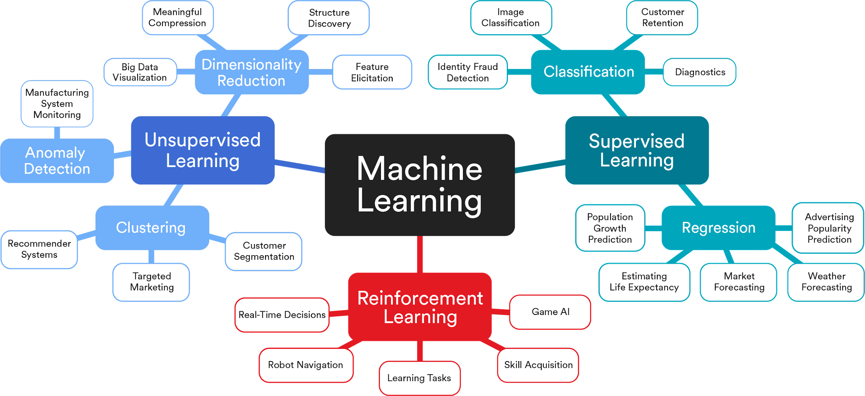
Putting It All Together
Notes:
PURPOSE: Show how different types of ML are actually used.
TALKING POINTS:
The different approaches to ML can help us solve different types of problems.
Here’s a breakdown of a few types of problems that each method can help us solve.
Focus here on the smallest bubbles: the actual business applications of ML. You don’t need to worry about things like dimensionality reduction or regression — that’s for your data scientists to worry about. This is meant to provide a high-level understanding of how different types of ML work and how they can be used.

Slide 34



ML Across Sectors
Marketing
Product recommendations.
Assessing lead quality.
Creating lookalike audiences for ad targeting.
Customer segmentation.
Finance
Portfolio management.
Underwriting insurance and loan.
Detecting fraudulent transactions.
Digital customer assistants.
Health Care
Process medical images.
Make faster and more accurate diagnoses.
Notes:
PURPOSE: Show even more ML use cases.
TEACHING TIPS:
Feel free to drop in other examples here.

Slide 35
What Problems Can We Solve?
This is a multi-part exercise in which students will start thinking about how they could use ML to solve problems in their own business, based on what we’ve shown in the program so far. Students can use page 2 of their worksheets for all parts of the exercise.
First, students will brainstorm problems independently. (Why? Independent brainstorming avoids groupthink, and gives introverts a chance to contribute before moving into the group activity.) They should think about problems big and small, that are in their team’s purview or not.
Then, students will come together in groups of 4–5 people to discuss the problems they brainstormed. As they share, they should note trends or themes in what people brainstormed. Students will need to continue to work with this group throughout the workshop, so be sure to note down who is in each group to keep them consistent.
After the problems have been shared and discussed, students should narrow down their list of problems to 5–10 promising ones. How they choose to narrow the list is up to them: similar ideas that several people had, ideas that seem particularly exciting/impactful/doable, and more. They will continue to pare down this list during the workshop; this is just the first pass.
For remote classrooms:
For the solo activity: Keep students in the main Zoom room for this exercise.
For the group activities: Set up breakout rooms for student groups. Take a screenshot of the slide and post it in the Slack channel before opening the rooms. When there is only one minute left to go (at the 60-second mark), send a message to all rooms: “Start to wrap up your discussions. Rooms will close in one minute!”
Bring students back to the main room to share instructions for part two, then send them back to breakout groups.
Reconvene everyone in the main room for the debrief.

Slide 36
What Problems Can We Solve?
5 Minutes
Page 2
Consider the projects you’re working on and any problems you and your team are facing today.
What problems or projects could be addressed with machine learning? Brainstorm as many projects or problems as you can.
Bonus: What problems or projects should NOT be addressed with machine learning? Brainstorm anything you think would not be a good fit for ML.
Think big — there are no bad ideas. We’ll return to this list later and pare it down.
Notes:
PURPOSE: Get students thinking about applying ML to their business.
TEACHING TIPS:
Let students know that anything goes at this point: big or small problems, feasible or not, in their team’s purview or outside of it, crazy, silly, and more.
Link to worksheets
FOR REMOTE CLASSROOMS:
Keep students in the main Zoom room for this exercise.

Slide 37
What Problems Can We Solve?
15 Minutes
Page 2
Part 1
As a group, you will create a shared list of projects and problems that could be addressed with ML.
Nominate one person to be the note-taker for the group.
Each member of the group should share what they brainstormed.
As people are sharing, consider any trends that start to emerge:
What types of projects or problems are you hearing?
Do any specific projects or problems come up more than once?
Make note of any trends, themes, or problems that stand out to the group.
Notes:
PURPOSE: Get students thinking about applying ML to their business.
TEACHING TIPS:
Not every student has to share everything they brainstormed, but they should share as much as possible and note trends they observe.
Students will need to continue to work with this group throughout the workshop, so be sure to note down who is in each group to keep them consistent.
Link to worksheets
FOR REMOTE CLASSROOMS:
Set up breakout rooms for student groups. Take a screenshot of this slide and post it in the Slack channel before opening the rooms.
When there is only one minute left to go (at the 60-second mark), send a message to all rooms: “Start to wrap up your discussions. Rooms will close in one minute!”
Bring students back to the main room to share instructions for part two.

Slide 38
What Problems Can We Solve?
5 Minutes
Page 2
Part 2
From your shared list, choose 5–10 problems or projects to focus on in this workshop. (Later, you will go through another round of prioritization where you’ll narrow the list down even more.)
Choose problems based on these questions:
Did several people in the group brainstorm it?
Does it have a lot of value to the company or to your team?
Does it seem feasible to get done?
Does it just seem really cool?
Notes:
PURPOSE: Get students thinking about applying ML to their business.
TEACHING TIPS:
Debrief instructions are on the next slide.
Link to worksheets
FOR REMOTE CLASSROOMS:
Set up breakout rooms for student groups. Take a screenshot of this slide and post it in the Slack channel before opening the rooms.
When there is only one minute left to go (at the 60-second mark), send a message to all rooms: “Start to wrap up your discussions. Rooms will close in one minute!”

Slide 39

What Problems Can We Solve?
5 Minutes
What themes emerged in the problems your group brainstormed?
What problems are you most excited about?
Notes:
PURPOSE: Get students thinking about applying ML to their business.
TEACHING TIPS:
Students don’t need to share every single thing they brainstormed. Keep it high-level.
Have one representative from each group share their reflections, but keep it brief.
FOR REMOTE CLASSROOMS:
Invite students to come off mute to share their answers.

Slide 40
Data Is Key to ML
But Poses New Challenges
Data creation, internet of things, sensors, CCTV, logs: nearly everything can be digitally tracked.
Cloud storage and high-performance databases make all this data ever more retrievable.
Everything is data: pictures, text, audio, documents, numbers, and more.
Data is often siloed within an organization, and people don’t have the technology or knowledge needed to share it.
Be sure the data was collected responsibly, taking into account personal privacy.
Policies, both internal to a company and set by a government, restrict how data can and can’t be used.
There is an increased risk of costly, damaging data breaches.
Notes:
PURPOSE: Introduce the importance of data to the ML process.
TALKING POINTS:
Data is the most important thing you need to make an ML project happen.
Without good data, enough data, and the right data, nothing can happen.

Slide 41
The Data Used in ML
Data to Build the Model
Input Data
The data used to teach a model how to perform its assigned task. It must be similar to the data the model will ultimately be acting on and often needs to be “labeled data.”
Once the model is developed, it needs new data it can process to perform its task and data to update and refine the model.
+
Notes:
PURPOSE: Briefly define how data is used for ML.
TEACHING TIPS:
Labeled data will be defined later in the lesson, so no need to spend a lot of time on it here.

Slide 42
Do You Have Enough Data?
The amount and sources of data you need to teach your model will vary depending on what you are building. Complex applications may need 100,000+ examples of data, but even simple applications need at least 100 examples.
Use Case | Amount of Data
You are building a model to determine a car’s make and model from images. | Medium
You are building a model to estimate the value of a car from images. | High
Notes:
PURPOSE: Emphasize the importance of the volume of data in ML.
TALKING POINTS:
You’ll need a huge volume of data to build an effective ML model.
You also need to make sure your data touches on the right things.
Both of these depend on the type and complexity of the problem you’re solving.
Ask: Why do you think building a model to estimate a car’s value would require more volume of data?

Slide 43
Can the Data Answer Your Questions?
Just because you have a lot of data doesn’t mean it’s all useful. The data you use needs to answer the questions you’re trying to answer.
To estimate a car’s value, you probably need additional data points beyond images to accurately achieve your goal.
Images can’t tell you the condition of the car’s engine.
Images can’t tell you how many miles the car has driven.
Images can’t tell you if the car was rebuilt after an accident.
Notes:
PURPOSE: Address having the right data points to answer your questions.
TALKING POINTS:
Maybe you have enough data, and it’s labeled, but can the data actually help answer the questions you have?
In our car example, images will only get you so far in estimating the value.
Here’s another example: You’re trying to predict which customers will churn, but you only have data on their age range and location. You’ll probably need more data to answer this question.

Slide 44
If You Don’t Have the Data You Need…
First-Party Data
How is data shared (or not) across your organization?
Are other groups sitting on potentially useful siloed data?
Can a combination of siloed data be more useful?
Third-Party Data
Is there an industry trade group that shares benchmarks?
What vendors or government agencies offer data sets that can be appended to first-party data for a benefit?
Notes:
PURPOSE: Explain what to do if you don’t have enough data.
TALKING POINTS:
If you need to get more data, you can look at first- and third-party data sources.
First-party data refers to data you have internally. The big question is getting access to it if a different part of your organization has it.
Maybe you need information on customer transactions as well as customer support ticket information — those are likely managed by two different parts of a company who might be more or less willing to give access to it.
Third-party data can be purchased or found from a publicly available source, such as government agencies.

Slide 45


Is Your Data Labeled?
Most data for machine learning models needs to be labeled. Labeled data tells the model how to make decisions and perform its assigned task.
Goal: Build a model that estimates the value of a car from images.
What does it mean for a car to be in good condition or bad condition?
What’s the difference between regular wear and tear and major structural damage?
Notes:
PURPOSE: Address getting labeled data.
TALKING POINTS:
A big consideration for building models is getting labeled data so your model can learn how to do its task.
Let’s go back to our car model example. A model can’t answer these questions on its own; we would need labeled data to teach the model how to answer them.

Slide 46
Was the Data Gathered Appropriately?
When considering data to build a model, you also need to understand how the data was gathered. Be sure to look out for:
Sampling Bias
Privacy Risks
The data set is more likely to include certain parts of a population than others.
The data set contains personally identifiable information (PII) about individuals or was collected without accounting for privacy regulations.
Notes:
PURPOSE: Address gathering data appropriately.
TALKING POINTS:
Another consideration around the type of data is how it was gathered.
A data set could have sampling bias, which can cause harm to how it performs (more on that on the next slide).
The data set could also contain private data, putting you at risk for using the data.

Slide 47

What’s Your Role?
Understanding the data required for an ML project is critical for any leader — even if you aren’t technical.
Build in time during a project to gather and prepare data as needed.
Bring in your data scientists early on to understand data needs and challenges.
Understand where data is siloed in an organization and work to get access to it.
Ask about how the data was collected.
Notes:
PURPOSE: Underscore why understanding data is important, even for non-technical roles.
TEACHING TIPS:
Participants will likely not have a technical background or be the ones actually planning out how to build a model.
Still, they should be aware of considerations around the data needed or used in ML and how to support colleagues in getting that data.

Slide 48
What Data Do We Need?
This exercise builds on the previous brainstorming and prioritization exercise that students completed with their group. Students should work with the same group as they did in the previous exercise.
Now, they are tasked with thinking critically about their prioritized list of 5–10 problems, starting with the most important factor: data.
Students will consider if their organization already has the data they’d need to address their problems, and if not, if or how they could get it. They don’t need to pare down their list now or remove any problems — that will happen in the next part of the program. But the availability of data will be a consideration when they narrow down their list, and this exercise will help them understand how to think through that.
Students can use page 3 of their worksheets for the exercise.
For remote classrooms:
Set up breakout rooms for student groups. Take a screenshot of the slide and post it in the Slack channel before opening the rooms.
When there is only one minute left to go (at the 60-second mark), send a message to all rooms: “Start to wrap up your discussions. Rooms will close in one minute!”
For the debrief, bring students back to the main room and invite students to come off mute to share their answers.

Slide 49
What Data Do We Need?
10 Minutes
Page 3
Return to the list of 5–10 problems or projects your group brainstormed earlier.
For each item, consider:
Do we have the data we’d need to solve this problem?
If so, are there any challenges with the data (e.g., labeled, sampling bias, privacy concerns)?
If not, how might we go about getting the data we’d need?
Notes:
PURPOSE: Allow students to practice thinking through considerations around data for ML.
TEACHING TIPS:
Students should continue to work with the group they had in the previous exercise.
Debrief instructions are on the next slide.
Link to worksheets
FOR REMOTE CLASSROOMS:
Set up breakout rooms for student groups. Take a screenshot of this slide and post it in the Slack channel before opening the rooms.
When there is only one minute left to go (at the 60-second mark), send a message to all rooms: “Start to wrap up your discussions. Rooms will close in one minute!”

Slide 50

What Data Do We Need?
5 Minutes
Share out key observations from your discussions:
Overall, did you have the data you’d need to solve the problems?
What types of challenges with the data did you notice?
Notes:
PURPOSE: Allow students to practice thinking through considerations around data for ML.
TEACHING TIPS:
Not each group needs to share their work; this discussion can be more thematic around the types of data the organization has and doesn’t have.
FOR REMOTE CLASSROOMS:
Invite students to come off mute to share their answers.

Slide 51
Choosing AI Projects
AI for Leaders
Welcome & Introductions
The What, How, & Why of AI
Choosing AI Projects
Responsible AI
AI in the Organization
Bring It Home
Notes:
DURATION: 120 Minutes

Slide 52
Choosing AI Projects
120 Minutes
Why?
AI can be used to solve a wide variety of business problems — from the mundane to the grand. By exposing leaders to the types of problems AI can address, as well as the criteria that make a problem ripe for AI, leaders will be able to identify opportunities for successful AI projects.
Learning Objectives:
Describe the criteria that make a successful AI project.
Determine if a project is a good fit for an AI solution.

Slide 53
Machine learning is a tool; use cases will vary.
Notes:
PURPOSE: Emphasize that students should be thinking about the use case for ML, not just ML.
TALKING POINTS:
Creating ML shouldn’t be your goal — it’s a tool to get to your goal.
ML has many use cases, and it’s important to focus on those.

Slide 54
Putting Machine Learning to Use
The goal of this exercise is to give students exposure to a diversity of ML case studies at a variety of different companies. This is accomplished using the “teach-back” method, in which students “teach back” their case study to the class.
Each group will be assigned one case study. (If there are more groups than case studies, some double up is OK.) With their group, students will read their case study and answer two questions about it. They should note down their responses to the questions so they can share them with the class. One person should be the presenter for the group.
In the second part, the class will come back together. One representative from each group will share their case study with the class, based on the notes they took with their group. Each person should have 3–4 minutes to present. Be strict with timing.
After each group has presented, move into the debrief discussion, which focuses on trends across the case studies around how businesses use ML.
Students can use page 4 of their worksheets for the exercise. The folder with the case study PDFs can be found here.
Customize it! You may swap in different case studies that are more relevant to the client’s industry or goals.
For remote classrooms:
Set up breakout rooms for groups. Take a screenshot of the slide and post it in the Slack channel before opening the rooms.
When there is only one minute left to go (at the 60-second mark), send a message to all rooms: “Start to wrap up your discussions. Rooms will close in one minute!”
Bring students back to the main room for presentations. Presenters can come off mute to share their report and have the option of sharing their screen if it would be helpful (but not required).
For the debrief, invite students to come off mute to share their answers.

Slide 55
Putting Machine Learning to Use
15 Minutes
Page 4
Review your case study and answer the following questions:
What was the problem? What was the solution?
Why was machine learning the best solution for this problem?
You will present a 3–4-minute summary of your assigned case study to the class, focused on the questions above.
Nominate one presenter to share your findings with the class.
Customize it!
Notes:
PURPOSE: Give students exposure to more ML use cases via case studies.
TEACHING TIPS:
Each group should be assigned one of the case studies in this folder (if there are more groups than case studies, some double up is OK):
ASOS
MedUni Vienna
Moneris
Nedbank
Schneider Electric
The goal of this exercise is to give students exposure to a variety of ML use cases, as well as to help them start thinking through why ML was a good solution to the problem.
Students can continue to work with the group they have been for the sake of simplicity (but don’t necessarily have to).
Link to worksheets and link to case studies folder
Customize it! You can swap in different case studies here.
FOR REMOTE CLASSROOMS:
Set up breakout rooms for student groups. Take a screenshot of this slide and post it in the Slack channel before opening the rooms.
When there is only one minute left to go (at the 60-second mark), send a message to all rooms: “Start to wrap up your discussions. Rooms will close in one minute!”

Slide 56
Putting Machine Learning to Use
30 Minutes
Page 4
Each group will take 3–4 minutes to present their case study to the class.
In your presentation, be sure to focus on these questions:
What was the problem? What was the solution?
Why was machine learning the best solution for this problem?
Customize it!
Notes:
PURPOSE: Give students exposure to more ML use cases via case studies.
TEACHING TIPS:
Keep students focused on answering the questions on the slide.
Be strict with timing: four minutes max — short and sweet.
Debrief instructions are on the next slide.
If students are interested in learning more about the other case studies, you can share a link to the folder with the PDFs (or send the PDF files directly).
Link to worksheets
FOR REMOTE CLASSROOMS:
Bring students back to the main room for presentations.
Presenters can come off mute to share their report and have the option of sharing their screen if it would be helpful (but not required).

Slide 57
Putting Machine Learning to Use
5 Minutes
How do the problems we read about compare to problems we’re facing internally?
What internal problems seem to be a good fit for an ML solution?
Notes:
PURPOSE: Give students exposure to more ML use cases via case studies.
TEACHING TIPS:
This discussion should be focused on trends seen across the case studies:
How are business using AI?
What types of problems are they solving?
FOR REMOTE CLASSROOMS:
Invite students to come off mute to share their answers.

Slide 58

What Isn’t Right for ML?
ML isn’t always the answer, especially if:
You can solve the problem with a simpler, more traditional solution; ML is overkill.
There’s no clear problem statement to guide work.
The system isn’t ready for a sweeping launch, even if you have a team that can solve the problem.
You don’t have enough or the right type of data to build the model — or managing that data is costly.
Notes:
PURPOSE: Frame when a problem doesn’t need ML.
TALKING POINTS:
ML is a great solution, but it’s seldom the only solution.
There are many instances when ML isn’t the right solution: it’s overkill, there isn’t a clear problem or data to answer it, or the business overall just isn’t ready.
TEACHING TIPS:
Feel free to share an example of a problem that’s too simple for ML (e.g., something that can be solved with a rule-based approach) or otherwise not suited for ML.

Slide 59
Many problems that ML can solve can be solved more simply by a human or a different type of computer program.
Use ML only if it is a measurable, significant improvement over other solutions.
Notes:
PURPOSE: Explain how ML can be overkill.
TEACHING TIPS:
This slide digs into the “ML can be overkill” point from the previous slide.
Emphasize that it’s important to consider if the problem can be solved in another way and what the benefits of using ML instead would be.

Slide 60
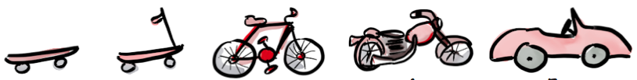
Don’t Try to Do It All
Start with this.
Not with this.
Notes:
PURPOSE: Provide a framework for evaluating an ML project.
TALKING POINTS:
The other thing to keep in mind is the size of your project.
It’s tempting to try to solve your big, hairy problems with ML — but these could be incredibly complicated, and the project could stall or fail.
Start with the basics for an initial ML project, and see how you can iterate and expand the solution over time.
TEACHING TIPS:
This is basically the concept of a minimum viable product or MVP (if you or your students are familiar with it, feel free to add that color).

Slide 61
An ML Project Checklist
A Good ML Project:
Does the project give you a quick win?
Will the project create value for internal or external customers?
Is the project the right size, not too trivial or too unwieldy?
Do we have the data we need in the format we need it?
Are we unable to solve the problem with current approaches?
A Bad ML Project:
Lack of defined success criteria.
Lack of clear problem statement.
Unreasonable executive expectations.
Lack of clean, labeled, accessible data available.
A simpler solution can be created without using machine learning.
Notes:
PURPOSE: Provide a framework for evaluating an ML project.
TALKING POINTS:
When we say a “quick win,” we mean a project that represents a visible, measurable improvement that can be implemented quickly and easily.
If you can confidently answer yes to each of these questions, then you have a great ML project on your hands.
If you can only answer yes to a few of them, consider if you can get to yes on the others.
If not, you may not have a problem that needs an ML solution.

Slide 62
Problem Evaluation
In this exercise, students will continue refining their list of ML problems and narrow them down to 1–2 key problems (from 5–10 previously). Students should work with the same group as they have in the previous exercises.
Based on their earlier prioritization, the data considerations they brainstormed, and their understanding of how businesses are using ML (from the case study discussion), they should evaluate each item they have against the ML project checklist.
Based on their evaluation, students should narrow down the list to 1–2 problems that seem the most promising, valuable, and feasible.
To debrief, have each group share out their prioritized problem(s) and why they chose to prioritize it.
Students can use pages 5–6 of their worksheets for the exercise.
For remote classrooms:
Set up breakout rooms for student groups. Take a screenshot of the slide and post it in the Slack channel before opening the rooms.
When there is only one minute left to go (at the 60-second mark), send a message to all rooms: “Start to wrap up your discussions. Rooms will close in one minute!”
For the debrief, bring students back to the main room and invite students to come off mute to share their answers.

Slide 63
Problem Evaluation
15 Minutes
Pages 5–6
Return to the 5–10 problems you prioritized earlier in class, as well as the data considerations you worked through.
Evaluate the problems against the checklist:
Does the project give you a quick win?
Will the project create value for internal or external customers?
Is the project the right size, not too trivial or too unwieldy?
Do we have the data we need in the format we need it?
Are we unable to solve the problem with current approaches?
Then, based on your evaluation, narrow the list down to one or two problems that you could solve using ML.
Notes:
PURPOSE: Give students practice evaluating problems for an ML solution in a structured way.
TEACHING TIPS:
Students should continue to work with the group they had in previous exercises.
Debrief instructions are on the next slide.
Link to worksheets
FOR REMOTE CLASSROOMS:
Set up breakout rooms for student groups. Take a screenshot of this slide and post it in the Slack channel before opening the rooms.
When there is only one minute left to go (at the 60-second mark), send a message to all rooms: “Start to wrap up your discussions. Rooms will close in one minute!”

Slide 64

Problem Evaluation
5 Minutes
Time to share with the class:
What did you prioritize?
Notes:
PURPOSE: Give students practice evaluating problems for an ML solution in a structured way.
TEACHING TIPS:
One person from each group should share what projects they prioritized and why they did so.
FOR REMOTE CLASSROOMS:
Invite students to come off mute to share their answers.

Slide 65
Collaborating With Data Scientists
Once a business problem is defined, it will need to be translated into a machine learning problem for the teams to get started.
1
Identify the problem you want to solve, value you want to create, and what success looks like.
2
Come with problems and design the solution together; don’t prescribe it.
Understand the machine learning process and workflow to build empathy for their world.
3
Notes:
PURPOSE: Introduce best practices for collaborating with data scientists.
TALKING POINTS:
After you’ve decided on a problem to tackle, you’ll start collaborating with your data science team to turn that problem into a machine learning problem.
Actual day-to-day work may seem like a mystery to you, but having great communication and collaboration with a data science team will be essential to complete your project successfully.

Slide 66


Communicating With Data Scientists
Share the whole story:
The problem.
The end user.
The value you’re creating.
What business success looks like.
Don’t share:
The exact solution you’re looking for — build this together.
The method for building the solution.
Notes:
PURPOSE: Explain what to share with data scientists.
TALKING POINTS:
Clearly communicating about the problem you want to solve, who will use the solution, and the why — the value and what success looks like — is imperative for getting a project done well.
What you don’t want to do is get into “solutioning” with that team.

Slide 67
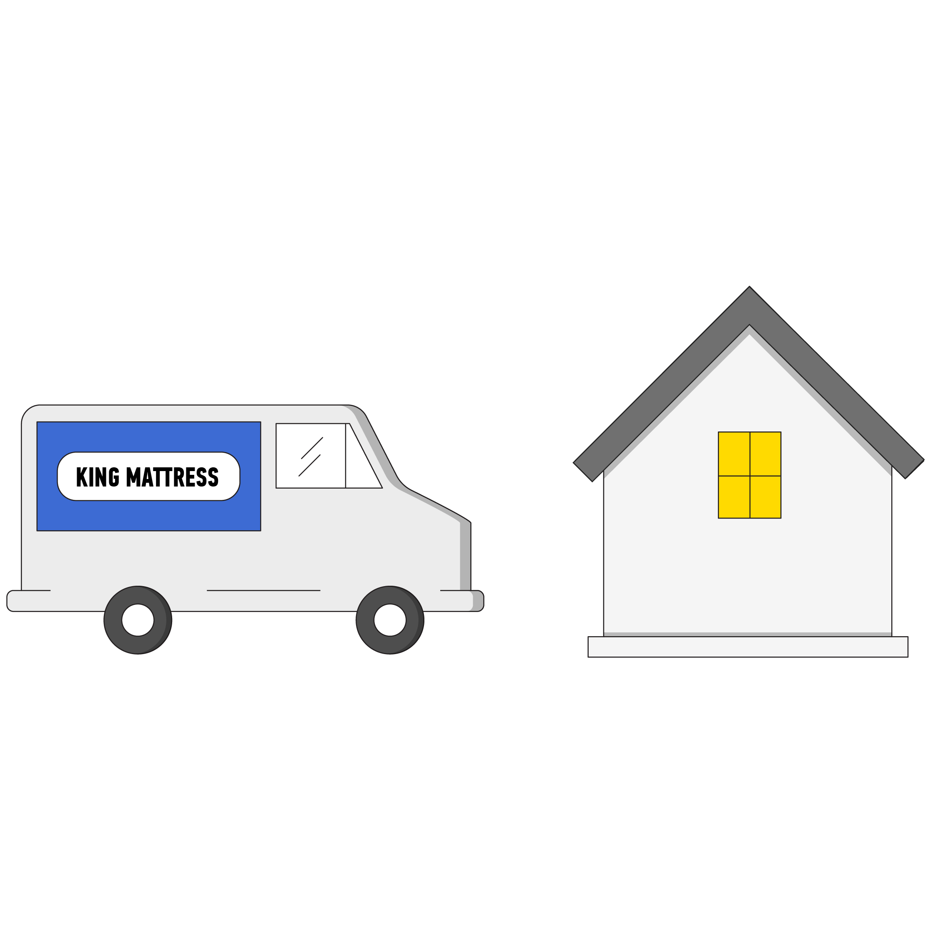
Sharing the Whole Story
The problem: Our drivers make deliveries across the city, but often travel long distances between deliveries and visit the same area multiple times.
The end user: delivery drivers.
The value: Enable drivers to make more deliveries, more quickly and more efficiently.
What business success looks like: Reduce delivery time, increase the deliveries that drivers can make in a day without visiting the same area multiple times.
Notes:
PURPOSE: Explain what to share with data scientists in an example.
TALKING POINTS:
Here’s what that information would look like.
This isn’t the entire conversation, but it’s an important starting point.

Slide 68
Remember: Machine learning isn’t always the best solution for a problem.
Look out for “shiny object syndrome” among your data scientists and other stakeholders.
Notes:
PURPOSE: Remind students that they may need to rein in data scientists from ML solutions.
TALKING POINTS:
A data science team might turn a problem into an ML problem because that's what they know, it seems cool, and they’re eager to do something with their specific skills.
It takes real management effort to ensure their incentives are reasonably well-aligned with the organization’s incentives to maximize ROI.

Slide 69




Defining Business Success…
Save time and money.
Support a strategic initiative.
Augment an existing product.
Grow revenue.
Notes:
PURPOSE: Explain what defining success means from a business perspective.
TALKING POINTS:
Being able to define success is important for getting an ML project off the ground — both for your data science team and your team.
Success for an ML project from a business perspective might look like one of these.

Slide 70
Defining Technical Success
Accuracy | Precision | Recall
Correct predictions divided by total predictions. | Correct positive predictions divided by total positive predictions. | Correct positive predictions divided by total actual positive outcomes.
How many correct predictions were made about patients’ COVID-19 status (positive or not) out of all predictions made? | How many patients had COVID-19 out of all patients predicted to have COVID-19? | How many patients had COVID-19 and had been (correctly) predicted to have COVID-19?
What It Means
Example
Notes:
PURPOSE: Introduce how the success of models is measured.
TALKING POINTS:
On the business side, we have metrics like revenue, cost savings, and others that tell us whether or not a project was successful.
For data scientists, the metrics look a bit different when building a model, and those metrics can mean slightly different things.
These metrics are crucial for machine learning. They’re a bit of a brain-bender, so you don’t need to memorize what each one means.
The key thing here is to be mindful of how you’re framing success metrics to data scientists and that the metrics they use might be different than what you’d think.
Measuring technical success is nuanced and problem-specific, so rely on your data scientists to determine what the best metrics are for a given situation.
Think of it this way: If we’re building a model to predict if a patient has COVID-19 or not, we’d want it to be accurate.
To a data scientist, accuracy isn’t the most important metric they’re working toward.

Slide 71
Sharing the Whole Story
Students will take the problem they prioritized in the previous exercise and flesh it out further. So far, they have focused mostly on whether or not their problem should even have an ML solution. Now, they’ll put some definition around what that problem really means and why they want to tackle it. Students should work with the same group as they have in the previous exercises.
Things like success, value, the end user, and the key problem should be shared with partner teams like data scientists, but the project team should also have a clear understanding of them. Students should answer each question and note it down as if they were to share it with a team of data scientists or other colleagues. The questions may seem simple, but the answers may be complex or nuanced and are important to get the project done effectively.
Debrief is optional. If there’s time, you can have a few groups share out answers to the questions with the class. If you’re pressed for time, you can skip the debrief.
Students can use page 7 of their worksheets for the exercise.
For remote classrooms:
Set up breakout rooms for student groups. Take a screenshot of the slide and post it in the Slack channel before opening the rooms.
When there is only one minute left to go (at the 60-second mark), send a message to all rooms: “Start to wrap up your discussions. Rooms will close in one minute!”

Slide 72
Sharing the Whole Story
15 Minutes
Page 7
Summarize this information for your prioritized problem as if you were to share it with a data science team:
What problem are we solving?
Who is the end user?
What value are we creating?
What does business success look like?
Be ready to share your work with the class.
Notes:
PURPOSE: Give students time to flesh out and define their ML problem.
TEACHING TIPS:
Students should continue to work with the group they had in previous exercises.
Tell students that these answers seem simple, but they may be a lot more complex or nuanced than they think.
Debrief is optional. If there’s time, you can have a few groups share answers to the questions with the class. If pressed for time, you can skip the debrief.
Link to worksheets
FOR REMOTE CLASSROOMS:
Set up breakout rooms for student groups. Take a screenshot of this slide and post it in the Slack channel before opening the rooms.
When there is only one minute left to go (at the 60-second mark), send a message to all rooms: “Start to wrap up your discussions. Rooms will close in one minute!”

Slide 73
The Machine Learning Workflow
Customize it!
Define Business
Problem
1. Define
4. Measure
Gather & Analyze
Insights
Define MPV
Monitor
Predictions
Get Data
Make Predictions
Evaluate
Model
Data
Preparation
2. Prototype
3. Production
Deploy
Model
Train
Model
Ready for
Prediction
Notes:
PURPOSE: Introduce a high-level ML workflow.
TALKING POINTS:
Our final point about collaborating effectively with data scientists is to understand and empathize with their workflow.
This, at a high level, is how ML models get made.
Notice that we’re saying machine learning here instead of AI — that’s because creating AI often involves building machine learning models.
We start with defining a business problem, which is what we’ve been doing.
Then, we move into prototyping, or creating an initial version of the model and iterating on it until it works effectively.
After that, we move into production or getting the model finalized and launched.
Finally, we measure the performance of the model to ensure it’s offering the insights we need.
Customize it! If the client has a more specific internal ML workflow they’ve shared, swap it in here.

Slide 74
Potential Obstacles Throughout the ML Workflow
Define
Prototype
Production
Measure
Is the use case unethical?
Is the focus on the wrong success metrics?
Incomplete, inaccurate, or non-representative data.
Protected data becomes unsecured.
Regulatory noncompliance.
The model doesn’t consistently perform as expected.
Insufficient training for the users of the model.
Cybersecurity threats.
Biased model outcomes.
Model outcomes can’t be explained.
Slow detection of, or response to, problems in the model.
Notes:
PURPOSE: Flag obstacles that appear at each phase in the workflow.
TALKING POINTS:
Each part of the ML workflow will raise unique problems, questions, and risks.
Here are a few that occur at different points in the workflow.
Ask: Do these jump out at you? What would you like to learn more about?
TEACHING TIPS:
Let students guide the discussion on this slide.
You shouldn’t walk through every bullet. Rather, ask students what they want to focus on and what they have questions on.

Slide 75

Setting Expectations
Getting the data you need will be a significant part of any ML project.
Work with your data team to build a new sample data set.
Label data you already have (manually or automatically).
Shop for an available labeled data set in third-party data.
Leverage a tool or vendor to create labels on your own data (e.g., Amazon SageMaker Ground Truth).
Expectation:
A lot of time will be spent gathering data and ensuring it’s usable for the model.
Notes:
PURPOSE: Set expectations for students around where an ML project will take time.
TALKING POINTS:
Several points in the ML workflow will take a lot of time.
The first is gathering data.
As we talked about before, data is critical to have in the right volume and format for the project.

Slide 76
Setting Expectations
The machine learning workflow is not linear, but is centered around an iterative test-and-learn approach — even after the model is developed.
Expectation:
The “build” phase of an ML project will go through several cycles as the team iterates toward success metrics.
Notes:
PURPOSE: Set expectations for students around where an ML project will take time.
TALKING POINTS:
The second point is in the iterative cycle.
A model never performs exactly as it should the first time. Training the model takes time and iterating on how it works, the data it’s fed, and more is crucial for success.

Slide 77
Responsible AI
AI for Leaders
Welcome & Introductions
The What, How, & Why of AI
Choosing AI Projects
Responsible AI
AI in the Organization
Bring It Home
Notes:
DURATION: 45 Minutes

Slide 78
Responsible AI
45 Minutes
Why?
Developing and deploying ethical AI solutions is a responsibility that falls to many teams in an organization. By understanding the risks associated with AI, leaders will be able to ask the right questions to unpack the ethical, security, and privacy implications of an AI solution.
Learning Objectives:
Describe the security, privacy, and ethical risks that may arise when integrating AI.

Slide 79
It’s Easy to Overlook How Things Could Go Wrong
We’ve been doing analytics for years. We already have industry-standard controls and practices in place.
We’re not using AI for things that could really do a lot of damage, like self-driving cars.
I trust our IT team. They’re doing everything they can to protect our customers and the company.
Our team won’t be worried about AI; we’re not using it to eliminate their jobs.
Notes:
PURPOSE: Frame where AI can go wrong.
TALKING POINTS:
If you’re not too familiar with AI or haven’t worked with it, it’s easy to overlook the risks and challenges.
Here are some common ways AI can go wrong: underestimating its impact, thinking it’s the same as analytics, not considering the human response, not protecting for all of the privacy and security implications.
Asks: Has anyone said these things before or heard them said internally? What happened?

Slide 80
How Things Go Wrong
Compliance | Bias | Human-Model Interaction
Are we using private, sensitive data? How are we ensuring private data stays private? Do we understand regulations around the data we’re using? Is there a plan for ensuring compliance? | Is the use case ethical? How is the model being trained? What data is being used to train it? | How will the model influence users’ behavior? How do people influence how the model works? How will users know how to interpret the outputs? Can we explain how the model is making decisions?
Source: McKinsey
Notes:
PURPOSE: Introduce categories of how things go wrong with AI.
TALKING POINTS:
An AI project can go wrong in many ways, but we can group them into these three categories:
Compliance: Making sure your model is keeping individuals’ data private, secure, and in compliance with regulations.
Bias: Ensuring your model is ethical and free from bias — from the use case to the data to the approach.
Human-model interaction: Considering how people will use and respond to the model’s outputs.

Slide 81
How It Plays Out
Customize it!
Compliance | Bias | Human-Model Interaction
A recommendation system uses anonymized customer data to make product recommendations. The customer data can be cross-referenced with public data sources to identify individuals. | Amazon developed a model to aid hiring decisions by rating candidates for technical roles based on previous successful applications. The model rated women lower because most current technical employees are men. | A model denies a bank customer a home loan. The customer deserves an explanation of why they were denied the loan.
Notes:
PURPOSE: Expand on types of irresponsible AI with tangible examples.
Customize it! You can swap in different examples here.

Slide 82
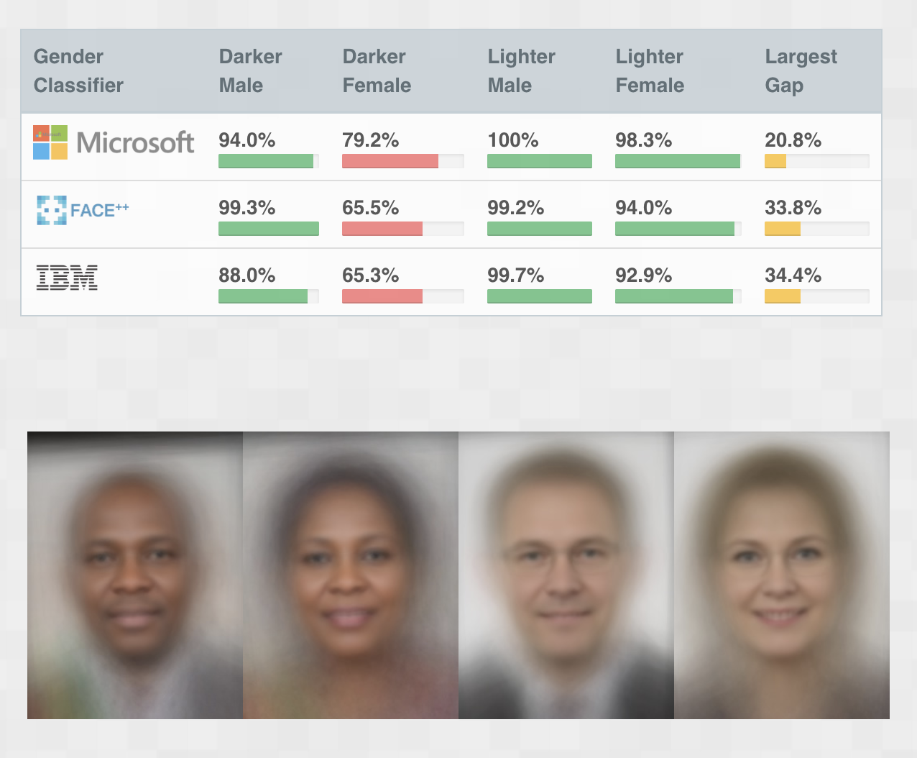
When Things Break Down
5 Minutes
A recent study found that facial recognition systems from Microsoft, IBM, and Face++ were significantly worse at correctly classifying the gender of female faces — in particular, dark-skinned female faces.
How could this bias have arisen?
Customize it!
Source: Gender Shades
Notes:
PURPOSE: Get students thinking through how AI can go wrong.
TEACHING TIPS:
Students will probably have some sense that AI can go wrong and the harmful impact it can have, but they may not be thinking about how that happens. This example starts them thinking in this mindset — the how.
Customize it! You can swap in a different example here.
FOR REMOTE CLASSROOMS:
Invite students to come off mute to share their answers.

Slide 83
AI Imitates Life
There’s bias in the data set because that data was gathered from the real world.
There’s bias in how the model was built because humans are prone to error.
There’s bias in the model’s outputs, even if it wasn’t built that way, because sometimes things go wrong.
Notes:
PURPOSE: Expand on how AI can go wrong.
TALKING POINTS:
AI doesn’t become biased because it’s inherently biased or because computers are intrinsically biased.
Rather, it reflects the biased, error-prone world we live in.

Slide 84

Bias in Health Care Models
Customize it!
An algorithm used by hospitals flagged patients for “high-risk care management” — individuals with complex medical issues needing additional support.
The model flagged patients based on how much it had cost to care for them in the past, which resulted in far more White patients than Black patients being flagged for support.
What went wrong?
Source: The Verge
Notes:
PURPOSE: Expand on “AI imitates life.”
TALKING POINTS:
This health care algorithm is an example of how AI imitates life — and its impact.
Ask: What went wrong? Why could the model have been flagging more White than Black patients?
Answer (from the article): “Because of unequal access to health care, Black patients have much less spent on them for treatments than similarly sick White patients. The algorithm doesn’t account for this discrepancy, leading to a startlingly large racial bias against treatment for the Black patients.”
Customize it! You can swap in a different example here.

Slide 85
Google’s Principles of Responsible AI
1
Fairness: AI will only produce fair outcomes if it’s developed in a fair way.
2
Interpretability: If your model denies someone a housing loan, you should be able to explain why it did so.
3
Privacy: Consider the safeguards that should be put in place to protect individuals’ privacy and comply with regulations and social norms.
4
Security: AI systems pose unique security challenges; ensure that the model can perform as expected regardless of attacks.
Source: Google
Notes:
PURPOSE: Introduce a framework for responsible AI.
TEACHING TIPS:
It could be worth mentioning an example of how easy it is to mess this stuff up:
Google has done a lot of thinking and writing about responsible AI, as shown here. However, they came under fire in December 2020 for firing an important AI ethics researcher, who is also a woman of color (source).

Slide 86
What’s Your Role?
Ask good questions to ensure models are being built responsibly.
What is the source of the model’s data? How was it collected?
What biases arise in gathering data or using it in the model?
Is there a risk of exposing PII or other sensitive data by using it in the model?
What internal or external policies must we comply with when using data?
Are you getting input from a diverse group of stakeholders?
Notes:
PURPOSE: Introduce questions students can use to help uphold responsible AI in their projects.
TALKING POINTS:
While you likely won’t be the person determining how the model makes decisions or what exact data sources it uses, you can ask the right questions to ensure you’re doing AI responsibly.
These questions should lead to more as you can keep asking to get to the root of the data policies and potential biases at play.
Recall that PII stands for personally identifiable information.

Slide 87
When Projects Go Wrong
10 Minutes
Consider the internal problems you’ve been working on throughout the class.
How could these projects go wrong? What are potential biases, compliance, and human-model risks?
Notes:
PURPOSE: Help students start applying responsible AI practices to the problems they’ve been brainstorming.
FOR REMOTE CLASSROOMS:
Invite students to come off mute to share their answers.

Slide 88

Taking Responsibility
5 Minutes
Page 8
Set one specific, actionable commitment for how you will ensure your organization uses AI and ML responsibly.
Notes:
PURPOSE: Help participants see their role in making AI responsible.
TEACHING TIPS:
You don’t need to debrief this activity, especially if you’re running short on time. But if there’s time, you can invite a few students to share out what their commitment was and why they committed to it.
Link to worksheets
FOR REMOTE CLASSROOMS:
Keep students in the main Zoom room for this exercise.

Slide 89
AI in the Organization
AI for Leaders
Welcome & Introductions
The What, How, & Why of AI
Choosing AI Projects
Responsible AI
AI in the Organization
Bring It Home
Notes:
DURATION: 60 Minutes

Slide 90
AI in the Organization
60 Minutes
Why?
Even if you’ve identified a perfect opportunity for incorporating AI, the project can still fail if the organization isn’t ready. By understanding the conditions that make or break AI, leaders will be able to navigate internal policies and processes to make a project successful.
Learning Objectives:
Identify the internal conditions — including data, resources, and culture — needed to make an AI project successful.
Assess where your organization is at in terms of implementing an AI solution.

Slide 91
Eighty-five percent of AI projects fail to deliver on their intended goals.
Source: Tech Republic
Notes:
PURPOSE: Set the stage for the final section.
TALKING POINTS:
We’ve been talking a lot about what an AI project really is, how to ensure it’s done responsibly, and more.
At this point, we should have hammered home why it’s so difficult to get an AI project off the ground.
But you’re not alone. More than 85% of AI projects don’t deliver — in fact, maybe you’ve already experienced this in past AI projects.

Slide 92
Why Do Projects Fail?
1
Insufficient Data
5
The Black Box Effect
2
Poor Data Management
6
Misalignment With Business Priorities
3
Lack of Talent
7
Shiny Object Syndrome
4
Technical Complexity
8
Underestimating the Cultural Changes Needed
Source: Enterprisers Project
Notes:
PURPOSE: Introduce reasons for AI project failure.
TALKING POINTS:
So, let’s think through why those projects fail.
From our perspective, there are eight key reasons.

Slide 93
Why Do Projects Fail?
Data
Culture
1
Insufficient Data
5
The Black Box Effect
2
Poor Data Management
6
Misalignment With Business Priorities
3
Lack of Talent
7
Shiny Object Syndrome
4
Technical Complexity
8
Underestimating the Cultural Change Needed
Resources
Notes:
PURPOSE: Introduce reasons for AI project failure.
TALKING POINTS:
Group these reasons into three buckets: data, resources, and culture.
We’ve spent a lot of time talking about how it’s hard to get data, make sure it’s the right data, and make sure it’s not biased.
In this section, we’ll talk about the other two items: resources and culture.
We recognize that these challenges can be systemic and not easily fixed with just a few actions. The goal in this section is to surface the issues, make you more aware of them, and start a dialogue with colleagues about them.
Ask: Do any of these problems jump out to you as particularly challenging or relevant for your organization? Have you already experienced some of these?

Slide 94
Error Planning
In this two-part exercise, students will “error plan” for their project. Students can use page 9 of their worksheets for both parts of the exercise. Students should work with the same group as they have in the previous exercises.
They’ll start by brainstorming all the ways the project could fail. These failures can be of any sort: failures in conceptualizing the project, failures getting the project approved or started, failures with the data available, failures related to bias and ethics, or failures in how the model works. They can reference the eight reasons covered previously as a starting point if it’s helpful. Encourage students to come up with as many potential points of failure as possible — the goal is to think through everything that could happen with the project (and then how to avoid those failures).
At the end of this section, students will come back for part two of error planning, in which they brainstorm solutions to or ways to avoid the failures they brainstormed previously.
The exercise (and the workshop) wraps up with a debrief discussion on the error planning and solutions outputs, in which students share their problems and solutions with the rest of the class.
For remote classrooms:
For part one, set up breakout rooms for student groups. Take a screenshot of the slide and post it in the Slack channel before opening the rooms. When there is only one minute left to go (at the 60-second mark), send a message to all rooms: “Start to wrap up your discussions. Rooms will close in one minute!”
Bring students back together and debrief if desired, then continue with the lesson.
Repeat for part two of the exercise.

Slide 95
Error Planning
10 Minutes
Page 9
Part 1
Brainstorm all the possible ways in which your prioritized project might fail.
In particular, consider challenges related to data, resources, and culture.
(We’ll come back to these points of failure later in the lesson.)
Notes:
PURPOSE: Get students to think through all the ways an AI project could go wrong.
TEACHING TIPS:
Let students know that in part two, which comes later in the section, they’ll think through solutions.
Debrief for the exercise is optional; you can skip it if you’re short on time or have students share some notable failures they brainstormed.
Link to worksheets
FOR REMOTE CLASSROOMS:
Set up breakout rooms for student groups. Take a screenshot of this slide and post it in the Slack channel before opening the rooms.
When there is only one minute left to go (at the 60-second mark), send a message to all rooms: “Start to wrap up your discussions. Rooms will close in one minute!”

Slide 96
Understanding Your Resources
People & Talent
Technology & Infrastructure
Do I have the people with the right skills to get the project done?
Do I have the computing power I need on premises, or will I need to use the cloud?
Do I have enough people to get the project done in the planned time frame?
Where is my data and how do I get it to where it needs to be?
Notes:
PURPOSE: Dig into the resource reasons for AI project failure.
TALKING POINTS:
When we talk about resources here, we mean both people or talent who can develop your solution, as well as technical and infrastructure resources needed to make your solution run.
These are some of the questions you can be ask to make sure you have the resources you need.

Slide 97




The People That Make ML Happen
Customize it!
Data Scientist
Data Engineer
Machine Learning Engineer
DevOps Engineer
Notes:
PURPOSE: Introduce the roles needed to make an ML project happen.
TALKING POINTS:
These roles and titles might look different from business to business, but they are the key ones.
Note that these are just the technical roles — non-technical roles like product managers, business analysts, and leaders are also crucial.
To think through what each role does, let’s pretend we’re building a car.
A data scientist designs the car: what it should look like, how it should run, what it should do.
The data engineer makes sure you have the materials needed to build the car and tells you how large or heavy the parts should be to get it to fit together.
The ML engineer tells you how the car gets manufactured and in what order the steps should be done.
A DevOps engineer makes sure the factory operates as it should and you have the resources you need to build the car properly.
Customize it! If the client has provided the specific ML roles involved in their process, swap them in here.

Slide 98



Build vs. Buy
SaaS ML
ML Accelerators
Custom ML
Fast
Flexible
Notes:
PURPOSE: Introduce the build versus buy decision.
TALKING POINTS:
If you don’t have the people or infrastructure resources needed for AI, you can consider buying it instead of building it.
SaaS ML is “out of the box”: You can buy the software or tools from another provider, then use your own data to create the model.
On the other end is custom ML, which offers more flexibility but an increased build time and the expenses of managing everything internally.
Where you fall on the build versus buy spectrum will depend on how your organization is set up currently and what’s possible for you to change.

Slide 99
Where Do You Stand?
Which resource challenge is more pressing for your organization?
People & talent
A bit of both
Technology & infrastructure
Notes:
PURPOSE: Guide students to reflect on resource challenges in their organization.
TEACHING TIPS:
Based on student responses, facilitate a brief discussion on the exact people and talent or tech and infrastructure challenges they’re facing:
What makes that area difficult?
What have students experienced in the past?
Emphasize that we recognize these challenges can be systemic and not easily fixed with just a few actions. Our goal is to surface the issues, make students aware of them, and start having a dialogue with colleagues about them.
FOR REMOTE CLASSROOMS:
Have students use the Zoom annotation feature to add a stamp or marker indicating what area their challenges are mostly related to.
Invite students to come off mute to share any additional thoughts.

Slide 100
Why Is Cultivating the Right Culture Difficult?
Data isn’t accessible or shared readily across teams.
The organization does not view data as a “first-class asset.”
There’s a lack of knowledge about AI’s capabilities and value.
Decision-making is driven by instinct, not data.
Notes:
PURPOSE: Frame how an organization’s culture can hinder AI success.
TALKING POINTS:
A company’s culture — from the way it views and shares data to the way it makes decisions — can impact its ability to make AI a reality.
Sharing data: We mentioned this in the program before, but if teams are incentivized to hold onto their data and not share it broadly, it will be hard to ensure you have the data you need to make projects successful.
Data as a first-class asset: How is data viewed internally? When we say it’s a first-class asset, is it thought of as a resource like a manufacturing plant at a car company?
A car manufacturer would not have their factory and robots in disarray — the same thing for your data if you think of it as an asset.
A manufacturer would also not let a plant sit idle and be unused. Similarly, are you encouraging actual use of the data? If you have these resources but don’t use them, what’s the point?
No common understanding: If leaders and individuals think AI will disrupt their work or are not relevant for them, it will be hard to get buy-in for projects requiring cross-functional resources.
Decision-making: If it’s done subjectively or consensus rather than by actual data, it will be hard to change mindsets enough to have leadership see an AI solution's value.

Slide 101
Where Do You Stand?
What Culture Challenges Are Most Pressing for Your Organization?
Data isn’t accessible or shared readily across teams.
The organization does not view data as a “first-class asset.”
There’s a lack of knowledge about AI’s capabilities and value.
Decision-making is driven by instinct, not data.
Notes:
PURPOSE: Guide students to reflect on culture challenges in their organization.
TEACHING TIPS:
Based on student responses, facilitate a brief discussion on the exact challenges they’re facing:
How do these challenges actually play out?
What do they look like internally?
How do you typically cope with them?
Emphasize that we recognize these challenges can be systemic and not easily fixed with just a few actions. Our goal is to surface the issues, make students aware of them, and start having a dialogue with colleagues about them.
FOR REMOTE CLASSROOMS:
Have students use the Zoom annotation feature to add a stamp or marker indicating what area their challenges are mostly related to.
Invite students to come off mute to share any additional thoughts.

Slide 102

The Keys to a Supportive Culture
Introduce processes to ensure leaders think data-first when faced with problems and new projects.
Create a shared understanding and excitement for the opportunities AI and ML create.
Articulate the people and inputs needed for sustainable and responsible adoption of new technologies.
Notes:
PURPOSE: Introduce ways to build a culture conducive to AI.
TALKING POINTS:
None of these are fast fixes or things that can be quickly implemented. But actions like these, whether tangible activities or mindset shifts, can start to facilitate a culture that’s more receptive to AI.

Slide 103
Consider an AI Governance Framework
Customize it!
An AI governance framework can take a variety of forms depending on the organization and its needs: a collection of guidelines, a dedicated group of individuals, or a step-by-step checklist.
AI governance accounts for considerations throughout the development process.
Is the use case aligned with the business strategy?
Is the use case ethical and responsible?
Is there a risk of data noncompliance or PII exposure?
What decisions are made in building the model?
Are the results transparent and explainable?
Are we iterating and improving on the model?
Notes:
PURPOSE: Introduce AI governance models as a way to build an AI-supportive culture.
TALKING POINTS:
Many organizations have data governance frameworks or models to ensure efficient and appropriate use of data internally.
Similarly, organizations have started to implement AI governance frameworks to ensure AI is done responsibly and smartly across the company.
Here are some things that an AI governance approach oversees.
Customize it! If the client has provided a specific AI governance framework or model, swap it in here.

Slide 104

AI Governance at Microsoft
Customize it!
Microsoft has operationalized responsible AI with its AI, Ethics, and Effects in Engineering and Research (AETHER) Committee.
The AETHER Committee is tasked with making recommendations on responsible AI issues, technologies, processes, and best practices, and consists of cross- functional business leaders and AI experts.
When questions arise within divisions, the committee responds with studies, reflection, and recommendations. Recommendations on specific cases may then evolve into general Microsoft policies, practices, and considerations.
Source: Microsoft
Notes:
PURPOSE: Introduce a real example of AI governance at an organization.
Customize it! You can swap in a different example here.

Slide 105
Error Planning
10 Minutes
Page 9
Part 2
Discuss how you could solve for the potential ways your project can fail.
Consider specific proposals to combat points of failure around data, internal resources, compliance, and culture.
Prepare to share.
Notes:
PURPOSE: Give students time to think through setting up their project for success and avoiding failures.
TEACHING TIPS:
Debrief instructions are on the next slide.
Link to worksheets
FOR REMOTE CLASSROOMS:
Set up breakout rooms for student groups. Take a screenshot of this slide and post it in the Slack channel before opening the rooms.
When there is only one minute left to go (at the 60-second mark), send a message to all rooms: “Start to wrap up your discussions. Rooms will close in one minute!”

Slide 106
Error Planning
5 Minutes
How will you help ensure project success?
Notes:
PURPOSE: Give students time to think through how to set up their project for success and avoid failures.
TEACHING TIPS:
If time allows, have one representative from each group share one problem and related solution that their group came up with.
FOR REMOTE CLASSROOMS:
Invite students to come off mute to share their answers.

Slide 107
Bring It Home
AI for Leaders
Welcome & Introductions
The What, How, & Why of AI
Choosing AI Projects
Responsible AI
AI in the Organization
Bring It Home
Notes:
DURATION: 30 Minutes

Slide 108
What We’ve Covered
The What, How, & Why of AI | Machine learning is just one way to create AI, but it’s the most effective approach we currently have. Data is the critical component to making AI and ML work.
Choosing AI Projects | Not all projects need an AI or ML solution. Clear communication and close partnership with data scientists on an ML project are crucial to success.
Responsible AI | It’s easy for AI to become biased, but it’s everyone’s role to ensure it’s conducted responsibly.
AI in the Organization | Even if a project is perfect for an ML solution, the right data, culture, and resources are needed for its success.
Notes:
PURPOSE: Recap what was covered in the workshop.

Slide 109
AMA: Ask Me Anything
10 Minutes
‹#› | © 2020 General Assembly
Notes:
PURPOSE: An opportunity for participants to ask questions.
FOR REMOTE CLASSROOMS:
Invite students to come off mute to ask questions.

Slide 110
Before You Go…
In this wrap-up activity, participants will respond to three prompts to reflect on what they’ve learned in this session:
What’s still going around in your head? (What questions do you still have?)
What’s squared away? (What’s a key takeaway from today?)
What will you do differently going forward? (How will they apply this to their work?)
Give students five minutes to reflect independently and five minutes to debrief as a group.
For remote classrooms:
Have participants write their answers on a sheet of paper or Post-it note and hold their responses up to the screen when they’re done.

Slide 111
Before You Go...
10 Minutes
Be ready to share with the class:
What’s still going around in your head? (Question)
What’s squared away?
(Key takeaway)
What will you do differently moving forward?
‹#› | © 2020 General Assembly
Notes:
PURPOSE: Get participants to synthesize their day in these three key categories.
TEACHING TIPS:
Take five minutes for students to work independently and five minutes to debrief as a group.
See the activity guide on the previous skipped slide for further context on running this exercise.
FOR REMOTE CLASSROOMS:
Have participants write their answers on a sheet of paper or Post-it note and hold their responses up to the screen when finished.

Slide 112

Feedback Time
Customize it!
Notes:
PURPOSE: Ensure students provide feedback on their experience before they leave.
Customize it! Work with your CSM to include the updated feedback form scanner here.

